Slide 1

Personality Prediction using Machine Learning
by
Raju K
Roll No. 174G1A0563
Sreekanth B
Roll No. 184G1A0577
Sudharshini M
Roll No. 184G1A0599
Yaswanth Kumar K
Roll No. 194G5A0512
Under the guidance of
Mr. M. Narasimhulu _{M.Tech.,(Ph.D).}
Assistant Professor
Department of Computer Science and Engineering
Srinivasa Ramanujan Institute of Technology
(Affiliated to JNTUA & Approved by AICTE) (Accredited by NAAC with ‘A’ Grade & Accredited by NBA (EEE, ECE & CSE)
Rotarypuram Village, B K Samudram Mandal, Ananthapuramu – 515701.
2021 - 2022

Slide 2

Contents
Introduction
Literature Survey
Existing System
Proposed System
Problem Definition
Requirements
UML Diagrams
Data Flow Diagram
Sample Code
Screenshots
Conclusion
References

Slide 3
Abstract
Personality is an essential component of our way of life. It influences how we live, speak, respond, and express ourselves, as well as our mental health. Personality analysis is a natural human capacity that is used on a daily basis with a variety of people and for a variety of purposes. Personality Prediction has a variety of real-world applications, including exams for screening of mental illness, human resource interview shortlisting, friend recommendations etc...
The purpose of this project is to predict personality types as one of the sixteen categories of Myers Briggs personality types (MBTI) based on the correlation between people's writing styles and their psychological personalities. We believe that social media gives people the platform to express themselves freely and openly and hence those posts can be an indicator of their personality type. We acknowledge the fact that all personality types are equal.

Slide 4
Introduction
To predict distinct personality of each individual we develop a machine learning model i.e., the Myers-Briggs Type Indicator. This Project follows the principle of MBTI as a guideline’s so that it helps to identify the personality of the user based on the following personality dimensions: Introvert (I) or Extrovert (E), Sensation(S) or Intuition(N), Thinking(T) or Feeling(F), Perceiving(P) or Judging(J).
The coalescence of the above four types of personality dimensions will result in sixteen types of personality such as "INFJ" or "ENFP" etc.
In our model we have used algorithms like Random Forest, Decision Tree, XG Boost and SVM.

Slide 5
Literature Survey
[1] Personality Classification from Online Text using Machine Learning Approach
Working Procedure of the System for Personality Traits Prediction: The proposed model is trained by giving both labelled data (MBTI type) and text (in the form of tweets). After training the model, it is evaluated for efficiency. For better prediction, the dataset will be split into three phases (training phase, validating phase and testing phase). The validating step will reduce overfitting of data.
[2] Personality Analysis using Social Media
Pre-processing: In this step we preprocess the dataset by removing the unwanted characters and words from our dataset. Hyperlink removal, Emoticons handing, Unwanted character removal, Stopword removal, Lemmatization, Stemming.

Slide 6
Contd…
[3] A System for Personality and Happiness Detection
In this work, the aim is to try to classify messages with within the personality features described in Table 1 using supervised machine learning algorithms. The key idea is that these messages have words that will be preprocessed and clustered in order to see whether its possible to match somehow the obtained clusters with the personality features model described before.

Slide 7
Existing System
In the existing system, implementation of machine learning algorithms is bit complex to build due to the lack of information about the data visualization.
Mathematical calculations are used in existing system for model building this may takes the lot of time and complexity.
To overcome all this, we use machine learning packages available in the scikit-learn library.
Disadvantages: High complexity.
Time consuming.

Slide 8
Proposed System
In the past, several machine learning models were proposed to classify the personality through the posts, but none have adequately addressed this misdiagnosis problem.
Also, similar studies that have proposed models for evaluation of such as performance classification mostly do not consider the heterogeneity and the size of the data. Therefore, we propose a Decision Tree, Random Forest, and XGBoost to classify the personality.
Advantages: Highest accuracy.
Reduces time complexity.

Slide 9
Contd…
We predict one of the types from the below MBTI types
ISTJ | The Inspector
ISTP | The Crafter
ISFJ | The Protector
ISFP | The Artist
INFJ | The Advocate
INFP | The Mediator
INTJ | The Architect
INTP | The Thinker
ESTP | The Persuader
ESTJ | The Director
ESFP | The Performer
ESFJ | The Caregiver
ENFP | The Champion
ENFJ | The Giver
ENTP | The Debater
ENTJ | The Commander

Slide 10
Problem Definition
Now a days personality assessment has become the most used test to hire many employees. This project is aimed to develop a system which will be helpful in identifying the personality of the person based on their social media posts/tweets by using the concept of machine learning algorithms.
To predict personality types as one of the sixteen categories of Myers Briggs personality types (MBTI) based on the correlation between people's writing styles and their psychological personalities.
After the classification of tweets/posts is done, the user type personality will be displayed.

Slide 11
Requirements
Hardware Requirements:
Operating system : Windows 10
RAM : 8 GB
Hard disc or SSD : More than 500 GB
Processor : Intel 3rd generation or high or Ryzen with 8 GB Ram
Software Requirements:
Software‘s : Python 3.6 or high version
IDE : PyCharm.
Framework : Flask

Slide 12
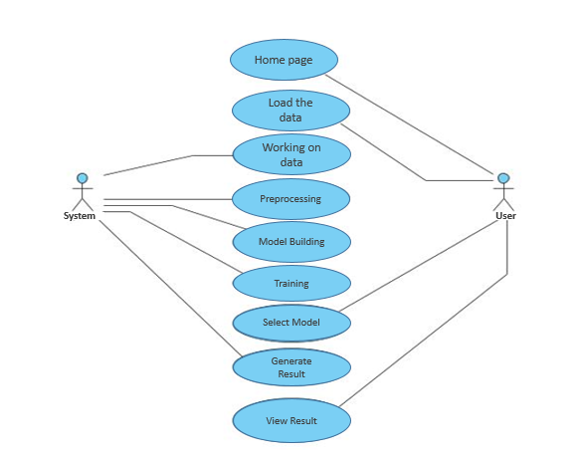
UML Diagram
Usecase Diagram:

Slide 13
Cotnd…
Architecture of MBTI classifier:
Pre-processing of Data
Training and Testing
1.Random Forest
2.SVM
3.Decision Tree
4.XGBoost
Data from Social Media
Feature Vector Generation
Selective word removal
Lemmatization
1.Counter
Vectorizer
2.TF-IDF
Removing low frequency words
MBTI
dataset
MBTI to Binary
Analysis and prediction of result

Slide 14
Data Flow Diagram
Data Flow Diagram:
MBTI Dataset
70% Training data 30% Testing data
Data pre-processing
Train-Test split
Model
Training
Select Model
View result

Slide 15
Sample Code
# Importing Necessary Libraries
from posixpath import split
import pandas as pd
import numpy as np
import pickle
import re
import nltk
from nltk.corpus import stopwords
from flask import Flask, render_template, request, session,flash
import mysql.connector
db=mysql.connector.connect(user="root",password="",port='3306',database='personality')
result =model.predict(hvectorizer.transform([f1]))
result=result[0]
if result==0:
msg = 'The Person Belongs to ENFJ Category'
elif result==1:
msg= 'The Person Belongs to ENFP Category'
elif result==2:
msg= 'The Person Belongs to ENTJ Category‘

Slide 16
Contd…
elif result==11:
msg= 'The Person Belongs to INTP Category'
elif result==12:
msg= 'The Person Belongs to ISFJ Category'
elif result==13:
msg= 'The Person Belongs to ISFP Category'
elif result==14:
msg= 'The Person Belongs to ISTJ Category'
elif result==15:
msg= 'The Person Belongs to ISTP Category'
return render_template('prediction.html',msg=msg)
return render_template('prediction.html')
if __name__=='__main__':
app.run(debug=True)

Slide 17
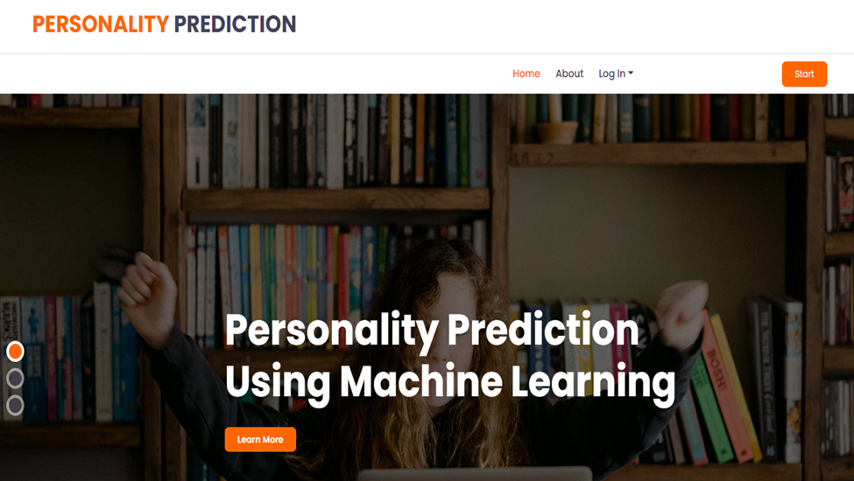
Screenshots
Here user view the home page of personality prediction model.

Slide 18
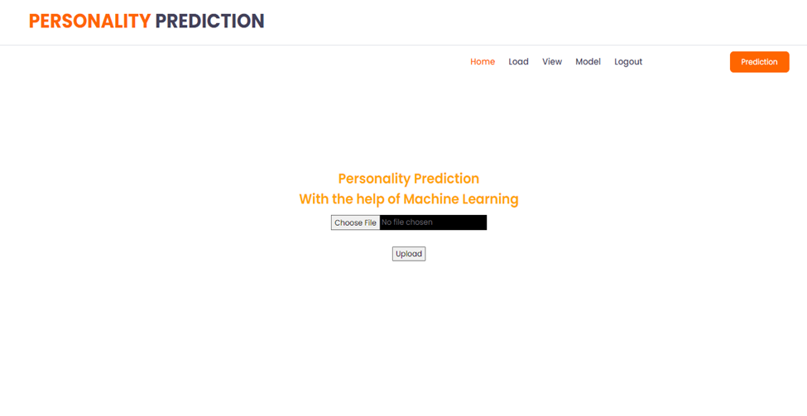
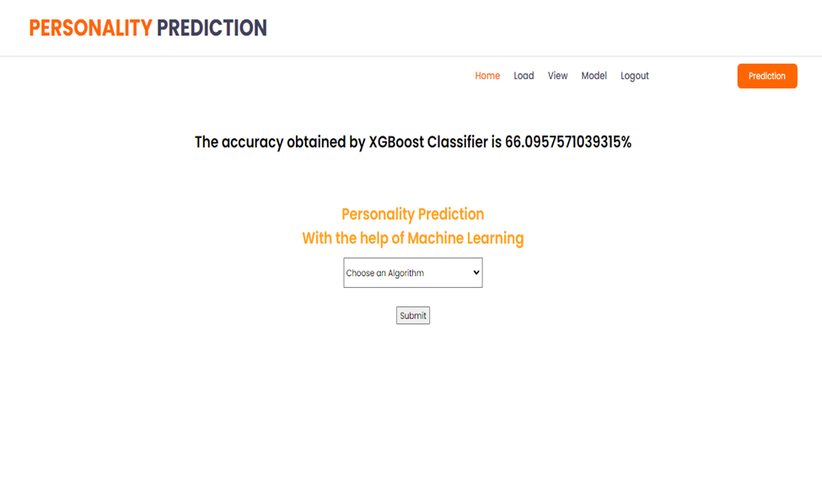
Contd…
In the load page, users can load the mbti dataset and we can train our data using different algorithm.

Slide 19
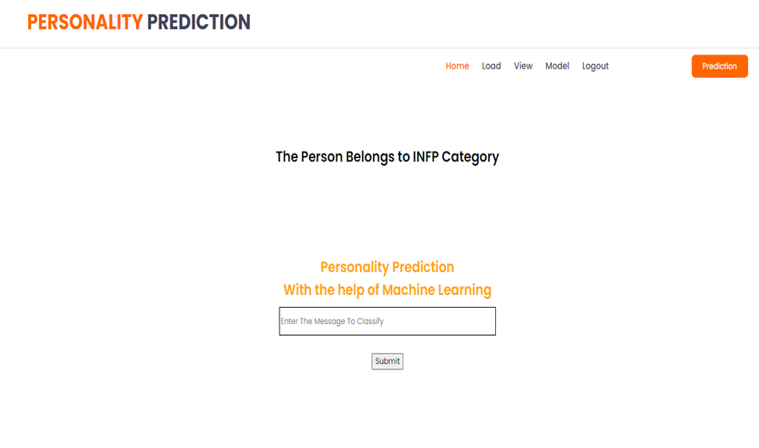
Contd…
This page show the personality type of the user.

Slide 20
Conclusion
The algorithms used are able to process the tweets and generate the required results. Finally the system is able to provide an efficiently accurate result by giving the personality type of the user.
The established system can be made more efficient by conducting more testing and feeding the system with a much accurate dataset. Once the system is highly accurate it can be used in corporations or even by the government to analyze the personalities of concerned individuals. The system can also be used in the crime sector. The currently implemented system of personality analysis can be extended and features like gender detection, age detection etc., can be added to it.

Slide 21
References
[1] Alam Sher Khan , Hussain Ahmad , Muhammad Zubair Asghar Furqan Khan Saddozai , Areeba Arif , Hassan Ali Khalid, “Personality classification from online text using machine learning approach”, IJACSA, vol. 11, no. 3, 2020.
[2] Sagar Patel, Mansi Nimje, Akshay Shetty, Prof. Sagar Kulkarni “Personality Analysis using social media” , IJERT, vol. 9, 2278-0181, 2020.
[3] Yago Saez , Carlos Navarro , Asuncion Mochon and Pedro Isasi “A System for Personality and Happiness Detection”, International Journal of Artificial Intelligence and Interactive Multimedia, vol. 2, no. 5, 2014.
[4] V.Mamatha, “Automated Personality Classification based upon Big Five personality traits”, ANITS college, Dept. of Comp. Sci., 2021.

Slide 22
Thank You!!!

